Slide 1
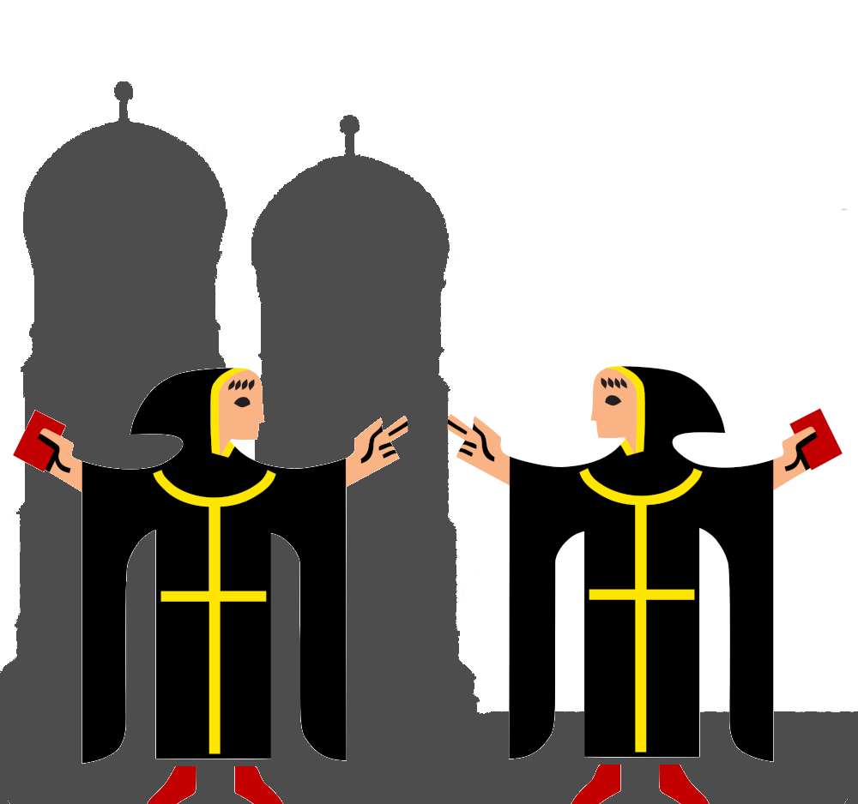


IsarMates
Rebuilding Social Bonds Through Blockchain Technology
HackaTUM 2024
Fabian, Linus, Mika, Oskar

Slide 2
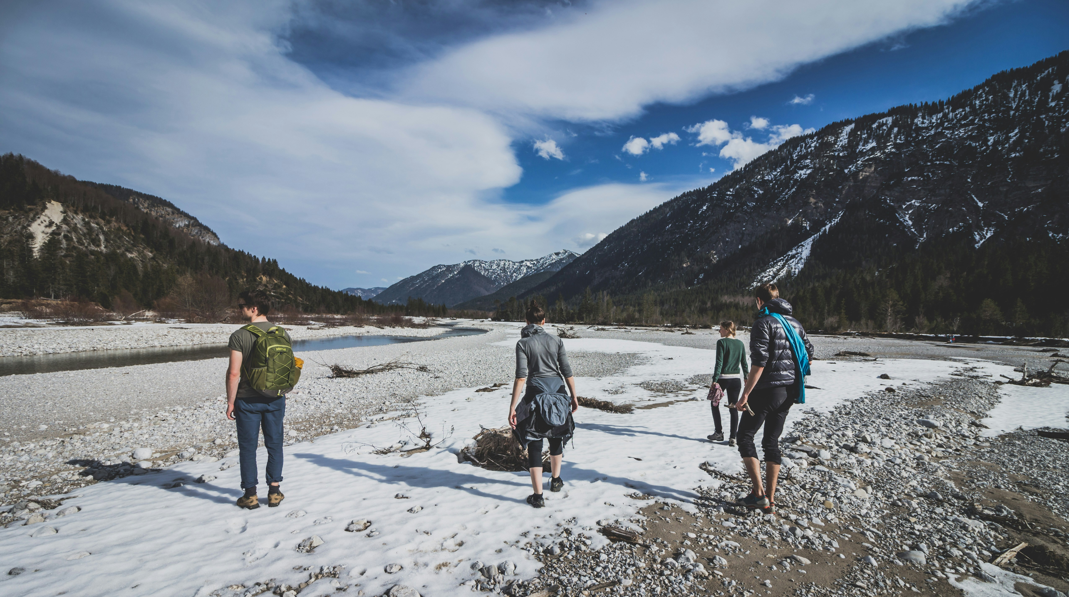
IsarMates
Rebuilding Social Bonds Through Blockchain Technology
HackaTUM24 Fabian, Linus, Mika, Oskar

Slide 3
From Smart Contracts To Social Bonds

Slide 4
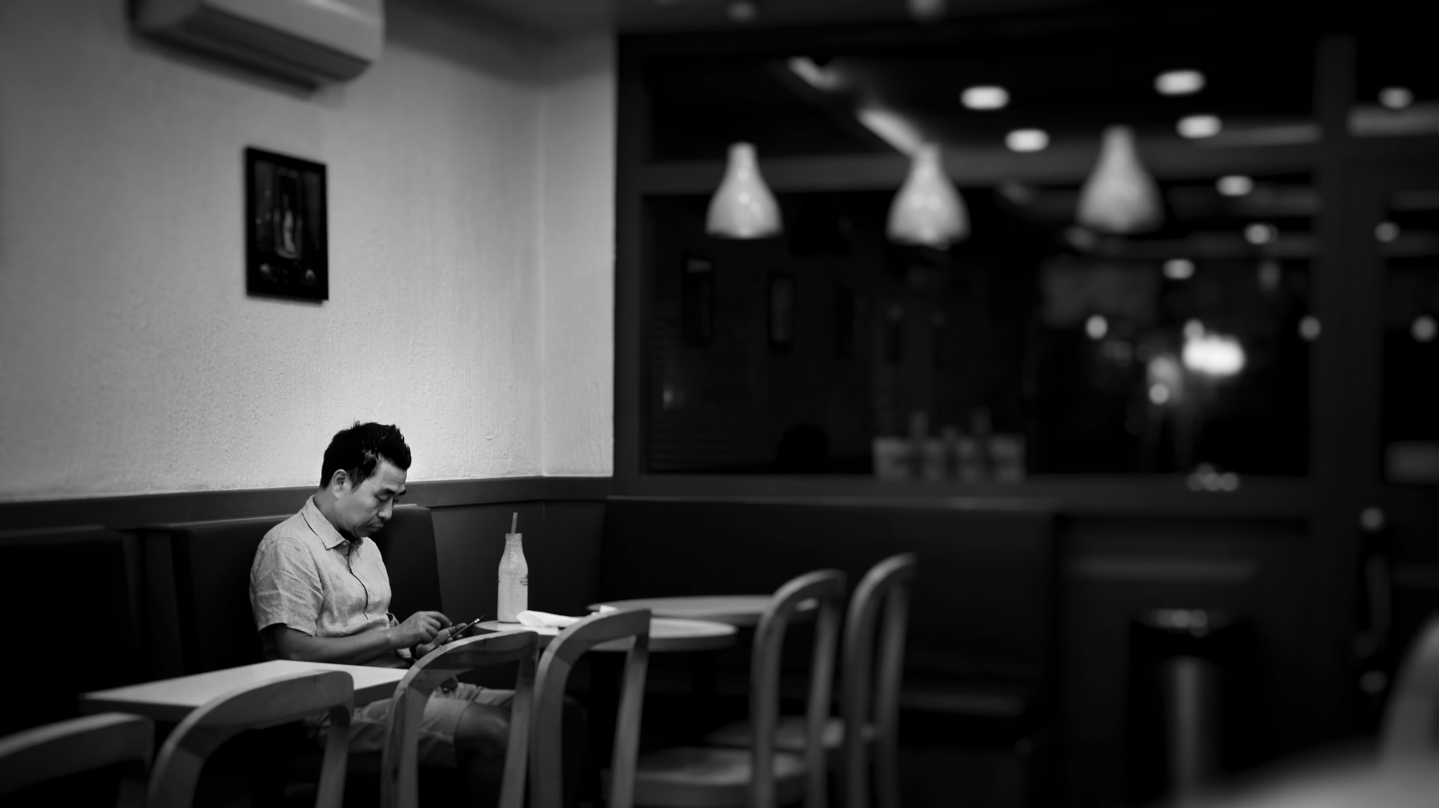
Loneliness

Slide 5
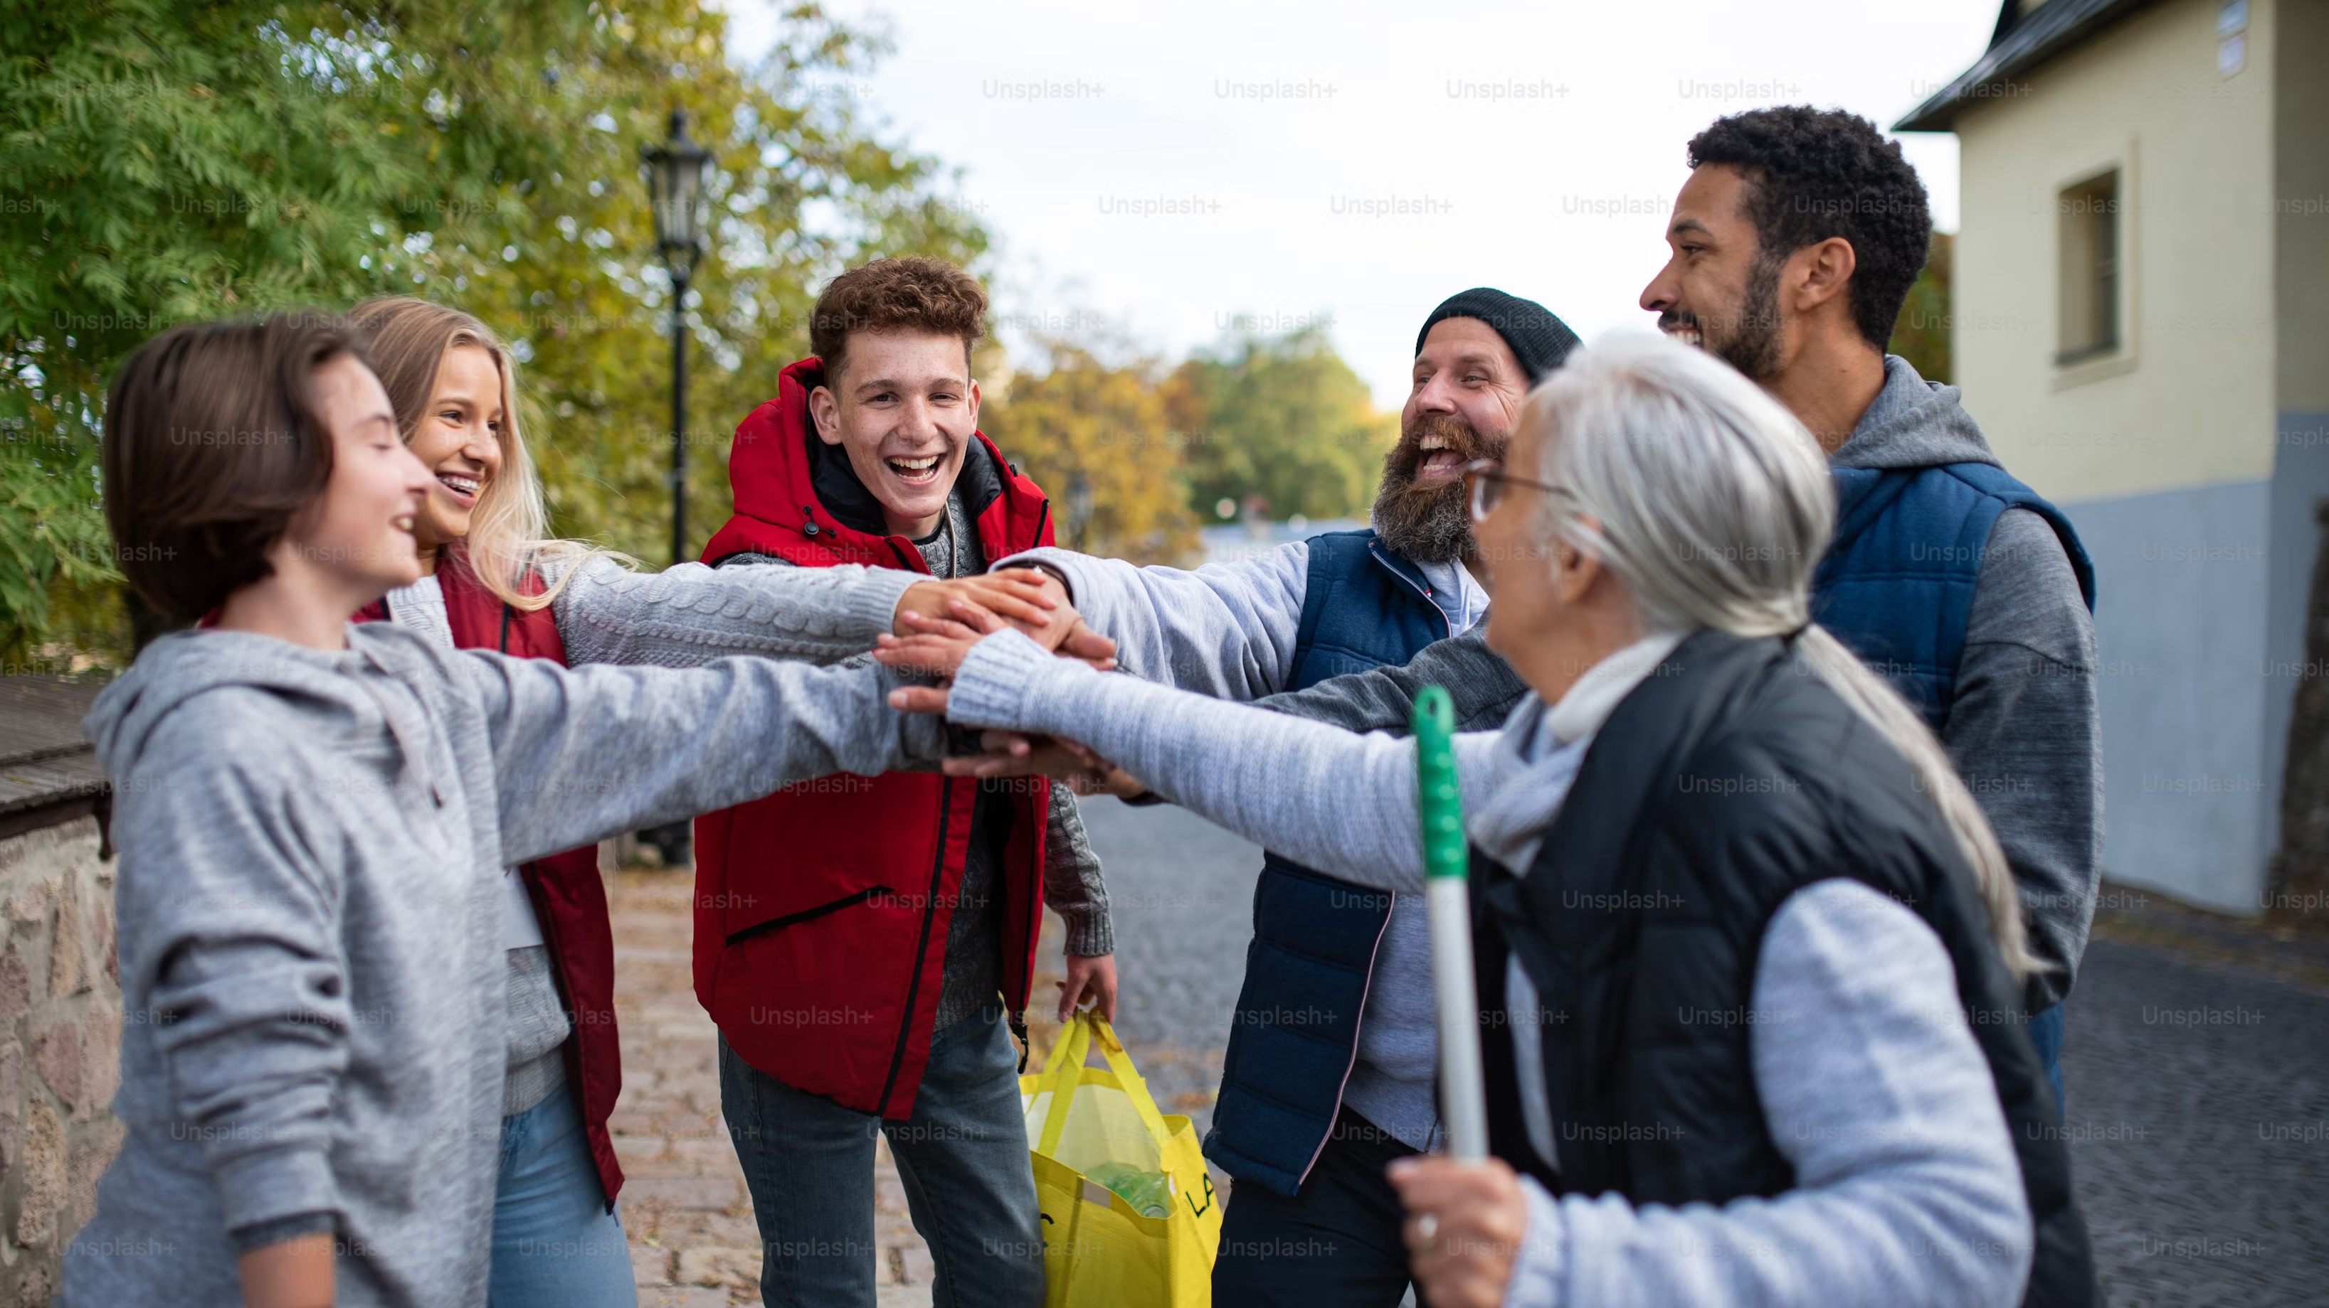
Community

Slide 6
Solana Tech makes
fast
cheap
scalable
decentralized
help through IsarMates
-> Immediate, Hassle-free
-> Efficient & cost-effective
-> Availability for all
-> Secure & Trustworthy

Slide 7
Stakeholder
Volunteers
Help with work
Get credit & rewards
Discounts at companies
People in need
Get help & support
Can apply for funds
City of Munich
Has less expenses
Can give out money
More efficient help
Higher satisfaction
More attractive for companies & citizens
Companies
can host activities
More customers
Donations for good cause

Slide 8






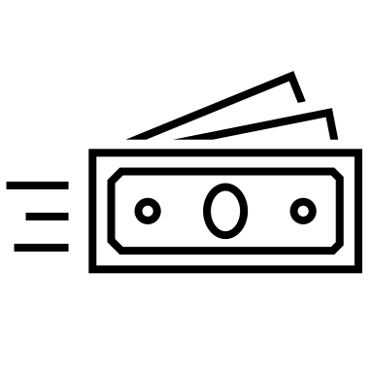


Slide 9



Loneliness is a growing problem (in big cities)
Problem
Anonymous cities
Orientation
Rising Loneliness

Slide 10




Our goal: Rebuilding Social Bonds
Solution
Promote Community
More Volunteers
Rewards & Proof
Fight Loneliness
Efficient help
Discounts for helpers

Slide 11
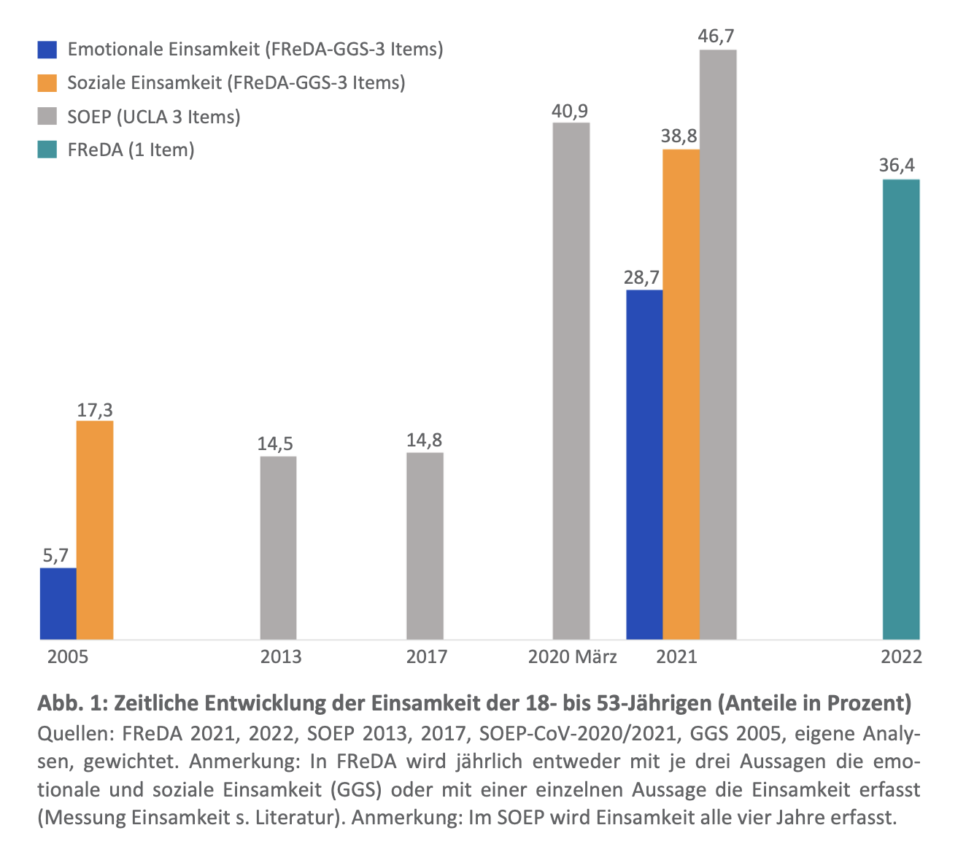
Why do people feel lonely?
The Problem
"In a city full of people, why do so many feel alone?"
Lost touch with their community
Decline in meaningful social interactions
Growing urban isolation in anonymous cities
Existing solutions are scattered and lack incentives
https://www.bib.bund.de/Publikation/2024/pdf/Freda-Policy-Brief-Einsamkeit-im-juengeren-und-mittleren-Erwachsenenalter-angestiegen.pdf?__blob=publicationFile&v=3

Slide 12
Introducing IsarMates
Our Solution
"Smart Contracts to Social Contracts: Strengthening bonds through action."
A blockchain-based reward system for building community connections.
Volunteer in community events and earn digital rewards.
Redeem rewards at participating businesses for discounts or perks.
Support those in need with essential tasks like gardening, shopping, or household chores.

Slide 13

Why Blockchain Powers Community Engagement
The Technology
"Building the future of community engagement—fast, scalable, and transparent."
Transparent, secure, and scalable infrastructure.
Solana's benefits:
Fast: Near-instant transactions.
Cheap: Low-cost for users and organizers.
Scalable: Handles large volumes with ease.
Decentralized yet accessible to everyone.

Slide 14
How does IsarMates work?
The Features
"From Random Acts of Kindness to a Citywide Movement."
Earn Rewards Join city-organized volunteering events (cleanup drives, helping neighbors, etc.).
Apply for Help Elderly or people in need request assistance for household chores or errands.
Redeem Benefits Use earned rewards for discounts at local businesses or free public services.
AI Chatbot Assistance Curated data from Munich city to provide up-to-date information about resources, doctors, psychologists, etc.

Slide 15
Technology Overview
Next.js
React
Solana

Slide 16
Efficient Resource Deployment for Munich
The Value
"Empowering Munich to be a smarter, more connected city."
Reduces strain on public services by encouraging citizen participation.
Provides real-time insights into community needs.
Smart allocation of municipal resources and funding.
Fosters a stronger sense of belonging among citizens.

Slide 17



Efficient Resource Deployment for Munich
The Value
"Empowering Munich to be a smarter, more connected city."
Reduces strain on public services by encouraging citizen participation.
Provides real-time insights into community needs.
Smart allocation of municipal resources and funding.
Fosters a stronger sense of belonging among citizens.

Slide 18
Corporate Partnerships: A Win-Win Opportunity
The Business Impact
"Where Corporate Responsibility Meets Community Action."
Participating businesses attract socially active customers.
Gain brand goodwill by supporting community initiatives.
Offer discounts or perks to reward volunteers.

Slide 19
Beyond Munich: The Future of IsarMates
The Future
"Connecting Cities, One Community at a Time."
Scale to other cities facing similar challenges of urban loneliness.
Expand partnerships with NGOs, government bodies, and local businesses.
Create a global network of connected, engaged citizens.

Slide 20
Join the Movement
Call To Action
"The Future of Cities Starts with Us."
Engage with your community.
Partner with IsarMates to redefine urban connections.
Let’s make Munich the model for connected, compassionate cities.

